Slide 1
Nondeterministic Finite Automaton (NFA)

Slide 2
Nondeterministic Finite Automaton (NFA)
Definition: An NFA is a TG with a unique start state and a property of having single letter as label of transitions. An NFA is a collection of three things
1) Finite many states with one initial and some final states
2) Finite set of input letters, say, Σ ={a, b, c}
3) Finite set of transitions, showing where to move if a letter is input at certain state (Λ is not a valid transition), there may be more than one transition for certain letters and there may not be any transition for certain letters.

Slide 3
Observations
It may be observed, from the definition of NFA, that the string is supposed to be accepted, if there exists at least one successful path, otherwise rejected.
It is to be noted that an NFA can be considered to be an intermediate structure between FA and TG.

Slide 4
Note
It is to be noted that NFA helps to eliminate a loop at certain state of an FA.
This process is done converting the loop into a circuit. But during this process the FA remains no longer FA and is converted to a corresponding NFA.

Slide 5
Note
It is to be noted that every FA can be considered to be an NFA as well , but the converse may not true.
It may also be noted that every NFA can be considered to be a TG as well, but the converse may not true.

Slide 6
Transition Graph

Slide 7
Defining Languages (continued)…
Method (Transition Graph)
Definition: A Transition graph (TG), is a collection of the followings
Finite number of states, at least one of which is start state and some (maybe none) final states.
Finite set of input letters (Σ) from which input strings are formed.
Finite set of transitions that show how to go from one state to another based on reading specified substrings of input letters, possibly even the null string Λ.

Slide 8
Note
It is to be noted that in TG there may exist more than one paths for certain string, while there may not exist any path for certain string as well.
If there exists at least one path for a certain string, starting from initial state and ending in a final state, the string is supposed to be accepted by the TG, otherwise the string is supposed to be rejected. Obviously collection of accepted strings is the language accepted by the TG.

Slide 9
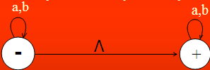
Example
Consider the Language L , defined over Σ = {a, b} of all strings including Λ. The language L may be accepted by the following TG
Remember: we have different paths for same string like aaΛ = Λaa = aΛa = [ aa ]
The language L may also be accepted by the following TG

Slide 10

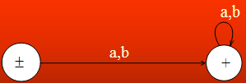
Example Continued …
TG₁
TG₂

Slide 11



Example
Consider the following TGs
TG₁
TG₂
TG₃
These TG_{s} accept Empty Language

Slide 12

Example
Consider the language L of strings, defined over Σ={a, b}, starting with b. The language L may be expressed by RE b(a + b)* , may be accepted by the following TG

Slide 13
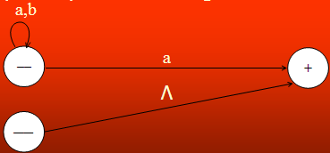
Example
Consider the language L of strings, defined over Σ={a, b}, not ending in b. The language L may be expressed by RE Λ + (a + b)*a , may be accepted by the following TG

Slide 14
Example
Consider the Language L of strings, defined over Σ = {a, b}, containing double a.
The language L may be expressed by the following regular expression (a+b)* (aa) (a+b)*
This language may be accepted by the following TG

Slide 15

Example Continued …
Multiple paths (options) are visible for Double a.

Slide 16
Example
Consider the language L of strings, defined over Σ={a, b}, having double a or double b.
The language L can be expressed by RE (a+b)* (aa + bb) (a+b)*
The above language may also be expressed by the following TGs.

Slide 17
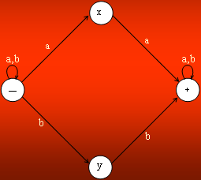
Example continued …

Slide 18

OR

Slide 19
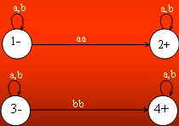
OR

Slide 20
Difference between FA and TG
S. No. | FINITE AUTOMATA FA | TRANSITION GRAPH TG
1 | In Finite Automata transitions are marked with single letter or alphabet. | In Transition Graph, they can be marked with letters or strings(combination of letters).
2 | In Finite Automata states transition are shown for all letters of given alphabet. | In Transition Graph, it does not necessarily shows transition for all letters.
3 | Strings transitions cannot be showed with FA. | String transition can be showed with TGs.
4 | Single Start State and multiple end states. | Multiple Start States and multiple end starts.
5 | Finite sets of input symbols. | Same.
6 | Finite set of transition. | Same.
7 | Deterministic. | Non-Deterministic.
8 | Distinguishing rule. | No such rule.

